Slide 1

LSTM

Slide 2

Group Members
Aqsa Hafeez
Mahnoor Asghar
Malaika
Ayesha Arshad

Slide 3
Limitations of RNN
Main limitations of RNN’s is that RNN’s cannot remember very long sequences and get into the problem of vanishing gradient

Slide 4
Standard Issues of RNNs
Vanishing Gradient Problem:
The gradient of the loss function in neural networks approach zero when more layers with certain activation functions are added, making the network difficult to train

Slide 5
LSTM
LSTM stands for Long Short-Term Memory. It is a type of recurrent neural network (RNN) architecture designed to overcome the vanishing gradient problem in traditional RNNs. It uses a memory cell with gates to control the flow of information, allowing it to capture long-term dependencies in sequential data.

Slide 6
How does it work?
It does by ignoring (forgetting)useless information in the network. The LSTM will forget the data if there is no useful information from the other input .When new information come it determine which should be ignore and which to remember

Slide 7
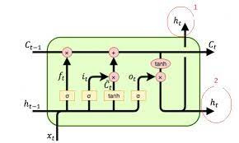
Architecture
Two types of Context:
Long Term Memory (Cell state)
Short Term Memory (Hidden State)

Slide 8
LSTM
Input Processing Output
Previous cell state Update Cell State Current Hidden State
Previous hidden state Calculate Hidden State(Ht) Current Cell State
Input for the current time t1(Xt)
Ct0 Ct1
Based on the current input which is Xt
LTM (remove or add)

Slide 9
Gates
Based on three Gates To protect and control the Cell state .
Forget Gate (Keep gate)
Input Gate (Write gate)
Output Gate (Read gate)

Slide 10
Gates
Memory Cell: Stores information over long periods.
Forget Gate: Decides which information to discard from the cell.
Input Gate: Decides which new information to store in the cell.
Output Gate: Decides which information from the cell to output.

Slide 11
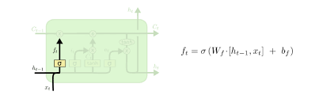
Forget Gate
Remove something from cell state

Slide 12
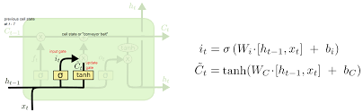
Input Gate
Add something to the cell state

Slide 13
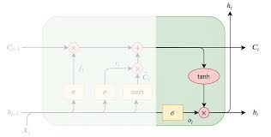
Output Gate
Calculate Hidden State

Slide 14
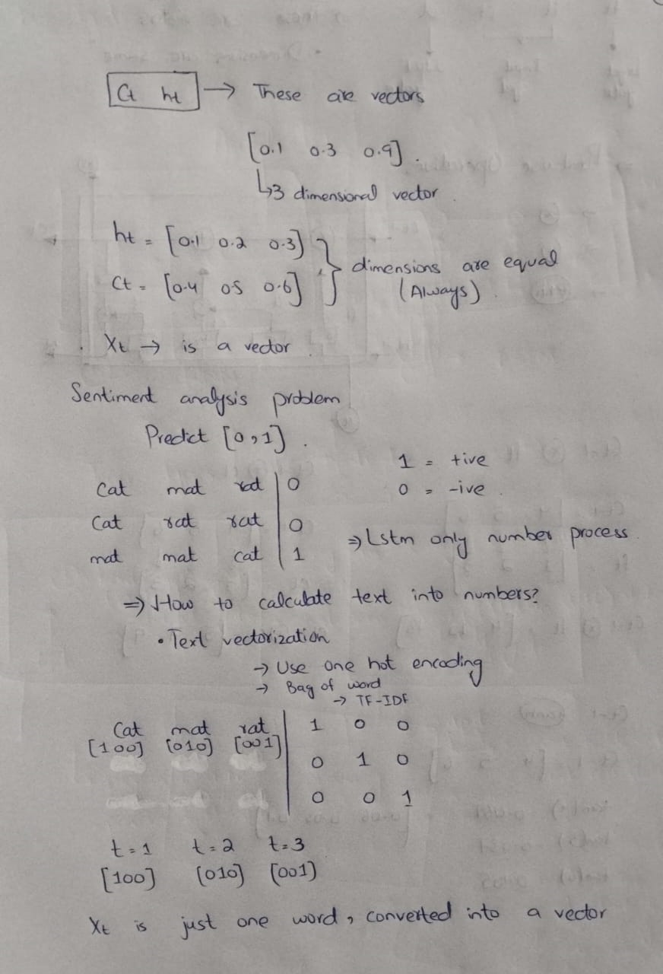

Slide 16
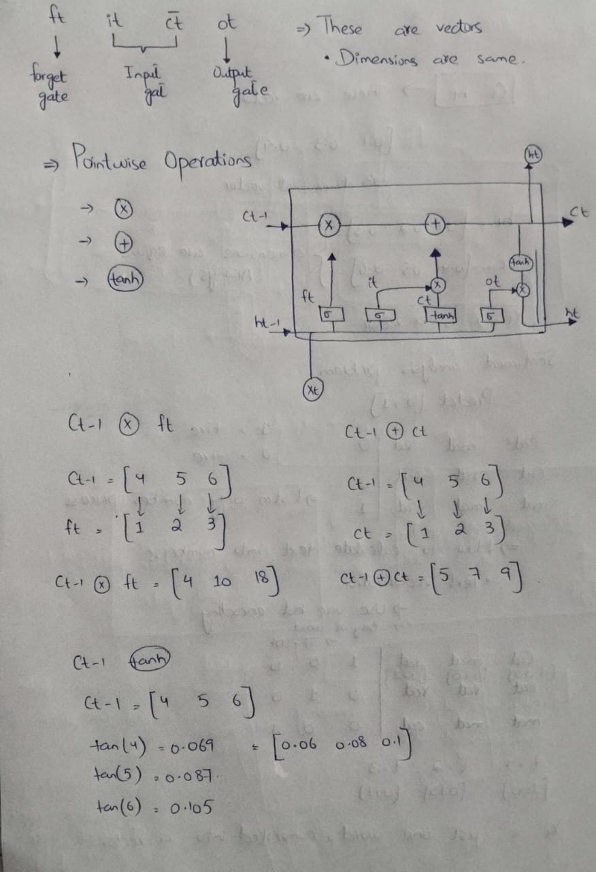

Slide 17


Slide 18
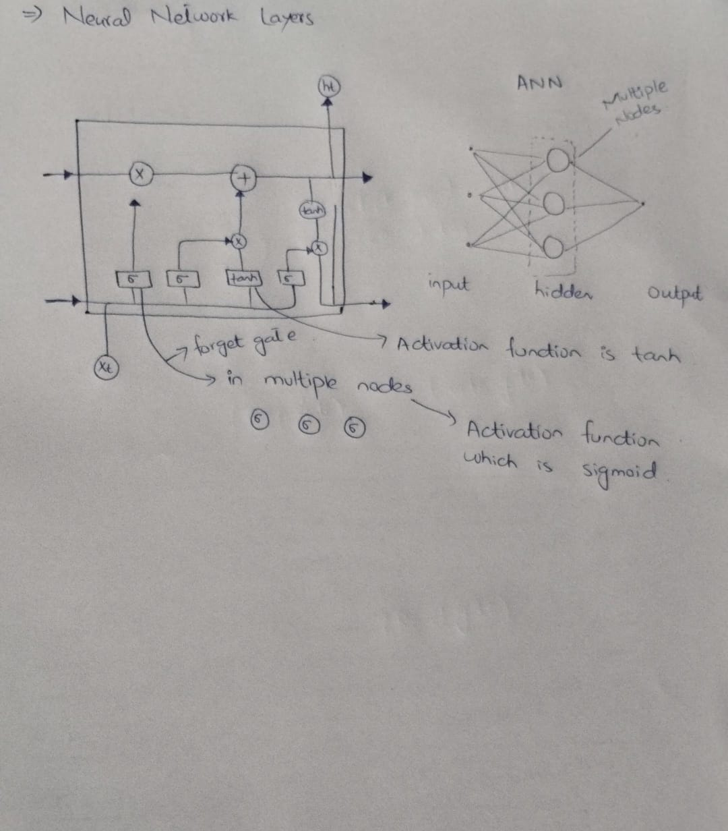

Slide 19

Thank You

